Slide 1
Introduction to Computer Simulation of Physical Systems
(Lecture 4)
PHYS 3061

Slide 2
The most common finite difference method for solving ordinary differential equations is the Runge-Kutta method.
Because Runge-Kutta algorithms are self-starting, they are frequently used to obtain the first few iterations for an algorithm that is not self-starting.
For details, read the textbook because it has been covered in PHYS2061.

Slide 3
The Dynamics of Many Particle
Systems
We simulate the dynamical behavior of many particle systems such as dense gases, liquids, and solids and observe their qualitative features. In addition to condense matter simulations, molecular dynamics type of simulations are widely adopted in biophysics, astrophysics, and other studies of complexed systems as well.
Some of the basic ideas of equilibrium statistical mechanics and kinetic theory are introduced.

Slide 4
Introduction
With the knowledge of the laws of physics at the microscopic level,
  how to understand the behavior of gases, liquids, and solids and more complex systems?
  such as polymers and proteins?
For example, consider two cups of water prepared under similar conditions.
Each cup contains approximately 10²⁵ molecules which mutually interact and,
to a good approximation, move according to the laws of classical physics.

Slide 5
Although the intermolecular forces produce a complicated trajectory for each molecule,
  the observable properties of the water in each cup are indistinguishable and are easy to describe.
  For example, the temperature of the water in each cup is independent of time
    even though the positions and velocities of the individual molecules are changing continually.
    Why is it independent of time?

Slide 6
One way to understand the behavior of a classical many particle system is to simulate the trajectory of each particle.
This approach, known as molecular dynamics, has been applied to various systems
  has given us much insight into a variety of systems in which the particles obey the laws of classical dynamics.
  Still, it is not only applicable for classical systems
    There is also a quantum mechanical version of MD.

Slide 7
A calculation of the trajectories of many particles would not be very useful unless we know the right questions to ask.
  What is a typical right question here?
Saving these trajectories would quickly fill up any storage medium, and we do not usually care about the trajectory of any particular particle.
  If God is a programmer, does he save all the history?
What are the useful quantities needed to describe these many particle systems?
What are the essential characteristics and regularities they exhibit?

Slide 8
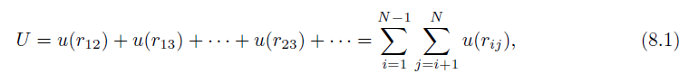
The Intermolecular Potential
We assume that the dynamics can be treated classically,
  the molecules are spherical
  and chemically inert
  and their internal structure can be ignored,
  and the interaction between any pair of particles depends only on the distance between them.
In this case the total potential energy U is a sum of two-particle interactions:
  How many pairs of interaction do we have here?

Slide 9
where u(r_{ij}) depends only on the magnitude of the distance r_{ij} between particles i and j.
The pairwise interaction form is appropriate for simple liquids such as liquid argon.
The form of u(r) for electrically neutral molecules can be constructed by a first principles quantum mechanical calculation.
Such a calculation is very difficult, and it usually is sufficient to choose a simple phenomenological form for u(r).
The most important features of u(r) are a strong repulsion for small r and a weak attraction at large r.

Slide 10
The repulsion for small r is a consequence of the Pauli exclusion principle.
  That is, the electron wave functions of two molecules must distort to avoid overlap, causing some of the electrons to be in different quantum states.
  What about other particles? Are there particles that can occupy the same state? What are the statistical properties of such particles?
The net effect is an increase in kinetic energy and an effective repulsive interaction between the electrons,
  Known as core repulsion.
The dominant weak attraction at larger r is due to the mutual polarization of each molecule; the resultant attractive potential is called the van der Waals potential.

Slide 11
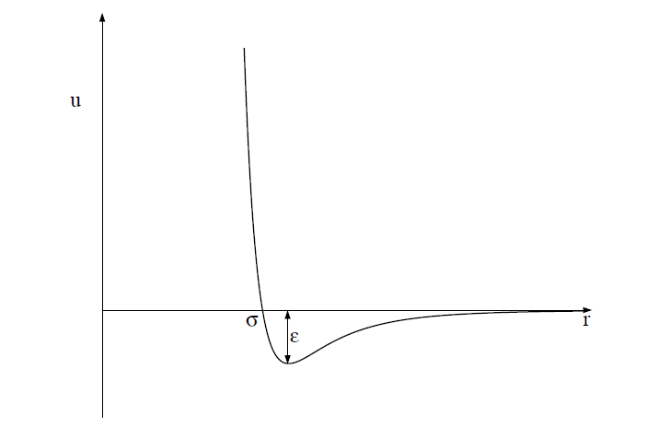
One of the most common phenomenological forms of u(r) is the Lennard-Jones potential:
u(r) = 4ϵ[(σ/r)¹²−(σ/r)⁶].

Slide 12
The r ⁻¹² form of the repulsive part of the interaction was chosen for convenience only and has no fundamental significance.
The attractive 1/r⁶ behavior at large r corresponds to the van der Waals interaction.
The Lennard-Jones potential is parameterized by a length σ and an energy ϵ.
Note that u(r) = 0 at r = σ, and that u(r) is close to zero for r > 2.5σ.
The parameter ϵ is the depth of the potential at the minimum of u(r); the minimum occurs at a separation r = 2^{1/6} σ.

Slide 13
Units
convenient to choose units
  the computed quantities are neither too small nor too large.
    What’s the problem of being too small or too large?
  Because the values of the distance and the energy associated with typical liquids are very small in SI units,
    What’s the typical value for distance and energy?
  we can choose the Lennard-Jones parameters σ and ϵ as the units of distance and energy, respectively.
  We can also choose the unit of mass to be the mass of one atom, m. We can express all other quantities in terms of σ, ϵ, and m.

Slide 14
For example, we can measure velocities in units of (ϵ/m)^{1/2},
and the time in units of σ(m/ϵ)^{1/2}.
The values of σ, ϵ, and m for argon are given in the next page.
If we use these values, we find that the unit of time is 2.17×10⁻¹² s.
The units of some of the other physical quantities of interest also are shown in next page.

Slide 15
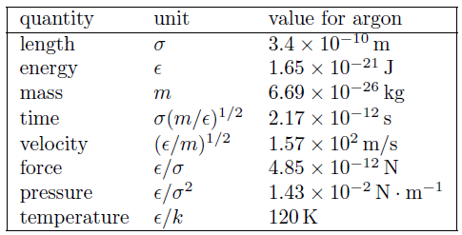
The system of units used in the molecular dynamics simulations of particles interacting via the Lennard-Jones potential. The numerical values of σ, ϵ, and m are for argon. The quantity k is Boltzmann’s constant and has the value k = 1.38 × 10⁻²³ J/K. The unit of pressure is for a two-dimensional system.

Slide 16
All program variables are in reduced units,
  for example, the time in our molecular dynamics program is expressed in units of σ(m/ϵ)^{1/2}.
  Suppose that we run our molecular dynamics program for 2000 time steps with a time step Δt = 0.01.
  The total time of our run is 2000 × 0.01 = 20 in reduced units or 4.34 × 10⁻¹¹ s for argon.

Slide 17
  The duration of a typical molecular dynamics simulation is in the range of 10–10⁴ in reduced units, corresponding to a duration of approximately 10⁻¹¹–10⁻⁸ s. The longest practical runs are the order of 10⁻⁶ s.

Slide 18
The Numerical Algorithm
we need to introduce a numerical method for computing the trajectory of each particle.
The criteria for a good numerical integration method include that
  it conserves the phase-space volume and be consistent with the known conservation laws, is time reversible, and is accurate for relatively large time steps to reduce the CPU time needed for the total time of the simulation.

Slide 19
We should use an algorithm for the relatively long time of interest in molecular dynamics simulations!
We adopt the commonly used second-order algorithm:
x_{n+1} = x_{n} + v_{n}Δt +1/2a_{n}(Δt)²
v_{n+1} = v_{n} +1/2(a_{n+1} + a_{n})Δt.

Slide 20
The new position is used to find the new acceleration a_{n+1},
  used together with a_{n} to obtain the new velocity v_{n+1}.
  The algorithm is known as the Verlet (or sometimes the velocity Verlet) algorithm.
  The sample code will use Verlet implementation of the ODESolver interface to implement the algorithm.
  Thus, the x, v_{x}, y, and v_{y} values for the ith particle will be stored in the state array at state[4*i], state[4*i+1], state[4*i+2], and state[4*i+3], respectively.
  In your own code, you can just implement Verlet by yourself with the help of global arrays of position, velocities, and forces along each directions.

Slide 21
Periodic Boundary Conditions
A useful simulation must incorporate as many of the relevant features of the physical system of interest as possible.
Usually we want to simulate a gas, liquid, or a solid in the bulk, that is, systems of at least N ∼ 10²³ particles.
  What’s the approximate number of particles on the surface? A rough estimation.
In such systems the fraction of particles near the walls of the container is negligibly small.

Slide 22
The number of particles that can be studied in a molecular dynamics simulation is typically 10³–10⁵,
  although we can simulate the order of 10⁹ particles using clusters of computers.
  If you are interested, try to learn parallel computing with our department cluster!
For these relatively small systems, the fraction of particles near the walls of the container is significant, and hence the behavior of such a system would be dominated by surface effects.

Slide 23
The most common way of minimizing surface effects and to simulate more closely the properties of a bulk system is to use what are known as periodic boundary conditions,
  although the minimum image approximation would be a more accurate name.

Slide 24
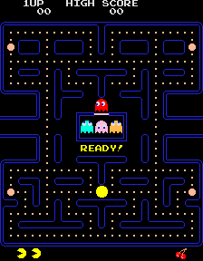
This boundary condition is familiar to anyone who has played the Pacman computer game!
Consider N particles that are constrained to move on a line of length L.
The application of periodic boundary conditions is equivalent to considering the line to be a circle, and hence the maximum separation between any two particles is L/2.

Slide 25
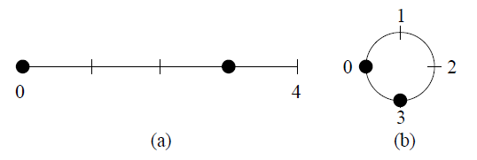
The generalization of periodic boundary conditions to two dimensions is equivalent to imagining a box with opposite edges joined so that the box becomes the surface of a torus (the shape of a doughnut or a bagel).
The three-dimensional version of periodic boundary conditions cannot be visualized easily, but the same methods can be used.
(a) Two particles at x = 0 and x = 3 on a line of length L = 4; the distance between the
particles is 3.
(b) The application of periodic boundary conditions for short range interactions is
equivalent to thinking of the line as forming a circle of circumference L.
In this case the minimum distance between the two particles is 1.

Slide 26
The implementation of periodic boundary conditions is straightforward.
If a particle leaves the box by crossing a boundary in a particular direction, we add or subtract the length L of the box in that direction to the position.
Translational symmetry vs. rotational symmetry.

Slide 27
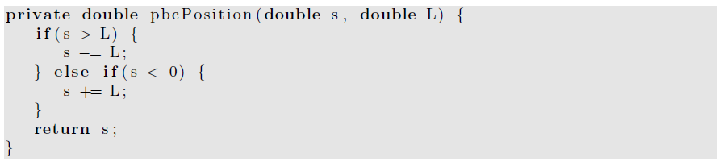
Calculation of the position of particle in the central cell.

Slide 28
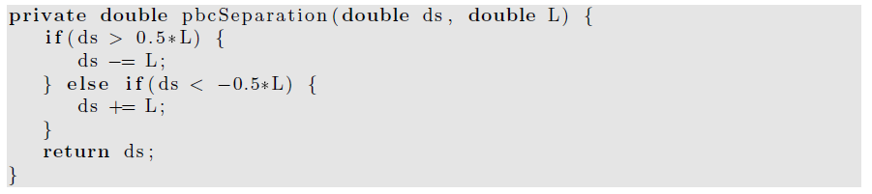
To compute the minimum distance ds in a particular direction between two particles, we can use the method pbcSeparation.

Slide 29
The nature of periodic boundary conditions.
Imagine a set of N particles in a two-dimensional box or cell.
The use of periodic boundary conditions implies that the central cell is duplicated an infinite number of times to fill the space.

Slide 30
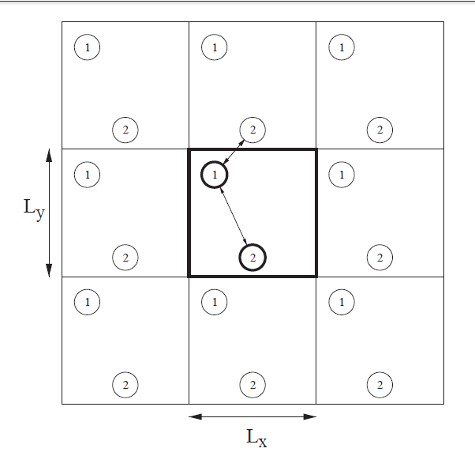
the first several image cells for N = 2.
The shape of the central cell must be such that the cell fills space under successive translations.
Each image cell contains the original particles in the same relative positions as the central cell.

Slide 31
Periodic boundary conditions yield an infinite system!
  although the positions of the particles in the image cells are identical to the positions of the particles in the central cell.
These boundary conditions also imply that every point in the cell is equivalent and that there is no surface.

Slide 32
As a particle moves in the original cell,
  its periodic images move in the image cells.
  Hence only the motion of the particles in the central cell needs to be followed.
When a particle enters or leaves the central cell,
  the move is accompanied by an image of that particle leaving or entering a neighboring cell through the opposite face.

Slide 33
The total force on a given particle i is due to the force from every other particle j within the central cell and from the periodic images of particle j.
That is, if particle i interacts with particle j in the central cell, then particle i interacts with all the periodic replicas of particle j.
  Big trouble, the total force may not even converge with system sizes.
  Any such examples with a long range interaction to show such kind of divergence feature?

Slide 34
There are an infinite number of contributions to the force on any given particle!
For long-range interactions such as the Coulomb potential, these contributions have to be included using special methods.

Slide 35
For short-range interactions, we can reduce the number of contributions by adopting the minimum image approximation,
which assumes that particle i in the central cell interacts only with the nearest image of particle j;
the interaction is set equal to zero if the distance of the image from particle i is greater than L/2.

Slide 36
A Molecular Dynamics Program
In this section, we demonstrate a molecular dynamics program to simulate a two-dimensional system of particles interacting via the Lennard-Jones potential.
We choose two rather than three dimensions because it is easier to visualize the results and the calculations are not as time consuming.
In the lab, you will be asked to write a code to simulate 3D with fixed boundaries.

Slide 37
In principle, we could define a class for a particle, and instantiate an object for each particle.
  However, this use would be very inefficient and would take up more memory and CPU time than using one class to represent all N particles.
  Instead we will store the x- and y-components of the positions and velocities in the state array and store the accelerations of the particles in a separate array.
  OOP is always more expensive!
We will develop two classes, LJParticles and LJParticlesApp.

Slide 38
Because the system is deterministic, the nature of the motion is determined by the initial conditions.
According to the equipartition theorem, the mean kinetic energy of a particle per degree of freedom is kT/2,
  where k is Boltzmann’s constant and T is the temperature.

Slide 39
We can generalize this relation to define the temperature at time t by
  k_{B}T(t) =2K(t)/ (d N) =1/(N d) * Σ [m_{i}v_{i}(t) · v_{i}(t)],
    where i is from 1 to N. K is the total kinetic energy of the system, v_{i} is the velocity of particle i with mass m_{i}, and d is the spatial dimension of the system.

Slide 40
The following method gives the particles a random set of velocities, sets the total velocity (momentum) to zero, and then rescales the velocities so that the desired initial kinetic energy is achieved.

Slide 41
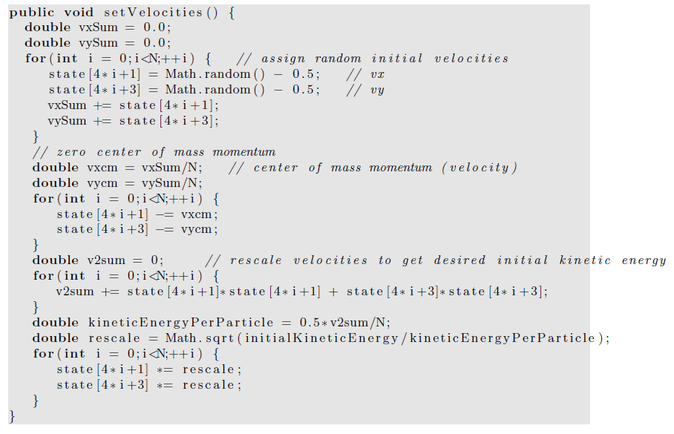

Slide 42
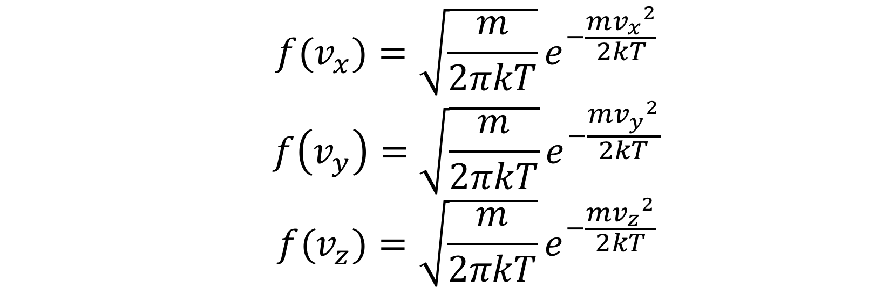

Initialization with Maxwell Boltzmann distribution
One problem of the textbook code,
  It give a uniform distribution of velocity.
The speed with Maxwell Boltzmann distribution,
Equivalently, the one-dimensional velocity satisfies Gaussian distribution,

Slide 43
Convert uniform distribution to other distributions
For Gaussian distribution, direct conversion (Box-Muller method) may be used,
For general distribution, Monte Carlo method should be used
(If you are interested in Monte Carlo method , some of the contents will be covered later this semester and more advanced materials will be covered in
PHYS4061 Computational Physics)

Slide 44
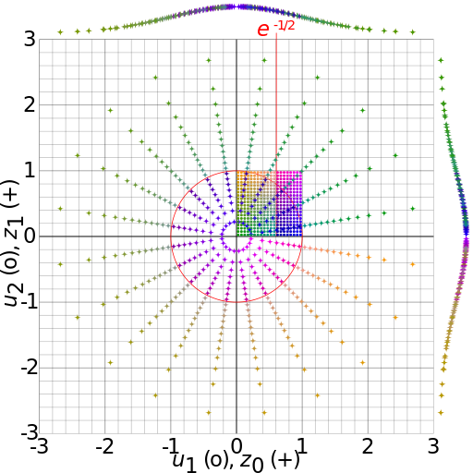

Convert uniform distribution to Gaussian distribution
Box-Muller transform,
Where
  ϑ1, ϑ2 are independent random numbers, 0 < ϑ1, ϑ2 < 1
  x1, x2 are independent random numbers with standard normal distribution
https://en.wikipedia.org/wiki/Box–Muller_transform#/media/File:Box-Muller_transform_visualisation.svg

Slide 45
Maxwell Boltzmann distribution
After getting the one-dimensional velocity, which satisfies
Simply, get the velocity by

Slide 46
We will find that setting the initial velocities so that the initial temperature is the desired value
  does not guarantee that the system will maintain this temperature when it reaches equilibrium.
    Why?
Determining an initial configuration that satisfies the desired conditions is an iterative process.

Slide 47
If the system is a dilute gas, we can choose the initial positions of the particles by placing them at random,
  making sure that no two particles are too close to one another.
If two particles were too close, they would exert a very large repulsive force F on one another
  any simple finite difference integration method would break down because the condition (F/m)(Δt)² ≪ σ would not be satisfied.
  (In dimensionless units, this condition is F(Δt)² ≪ 1.)

Slide 48
If we assume that the separation between two particles is greater than 2^{1/6}σ,
  this condition is satisfied.
The following method places particles at random such that no two particles are closer than 2^{1/6}σ.
Note that we use a do/while statement to insure that the body of the loop is executed at least once!

Slide 49
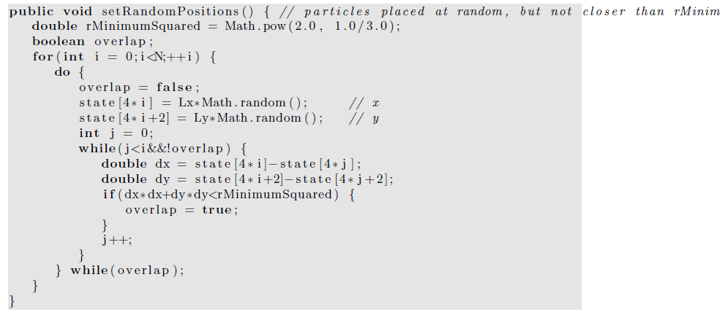

Slide 50
Any problems with this algorithm?
Any solutions?

Slide 51
Finding a random configuration of particles in which no two particles are closer than 2^{1/6}σ becomes much too inefficient if the system is dense.
It is possible to choose the initial positions randomly without regard to their separations if we include a fictitious drag force proportional to the square of the velocity.

Slide 52
The effect of such a force is to dampen the velocity of those particles whose velocities become too large due to the large repulsive forces exerted on them.
We then would have to run for a while until all the velocities satisfy the condition vΔt ≪ 1.
As the velocities become smaller, we may gradually reduce the friction coefficient.

Slide 53
In general, the easiest way of obtaining an initial configuration with the desired density is to place the particles on a regular lattice.
If the temperature is high or if the system is dilute, the system will “melt” and become a liquid or a gas; otherwise, it will remain a solid.

Slide 54
If our goal is to equilibrate the system at fluid densities, it is not necessary to choose the correct equilibrium symmetry of the lattice.
The method setRectangularLattice places the particles on a rectangular lattice.
To make the method simple, the user must specify the number of particles per row, nx, and the number per column, ny.

Slide 55
The linear dimensions Lx and Ly are adjustable parameters and can be varied after initialization to be as close as possible to their desired values.
In this way we can vary the density by varying the volume (area) without setting up a new initial configuration.

Slide 56
